Slide 1


Expense Management System
A user-friendly application to efficiently track, manage, and analyze personal expenses

Slide 2
TEAM MEMBERS
NAME | CONTRIBUTION | EMAIL
Gokul S | Authentication, Users (Admin part) | gokulgss567@gmail.com
Chava Pardha Kalyan | Dashboard, Goal Setting | pardhakalyan2003@gmail.com
Arunabha Chatterjee | New Transaction, Transaction History | arunabha6289@gmail.com
Muskan Gupta | Saved Transactions, Statistics | muskang2898@gmail.com
Sakshi Jadhav | Transactions, Categories, New Category (Admin part) | sakshij1703@gmail.com

Slide 3
Agenda
Features
Tools and Technologies
Database Design
User features
Admin features

Slide 4
Features
Frontend
Built with React.js.
Features include:
Interactive dashboards with charts and statistics using Chart.js.
Profile management and password reset functionality.
Real-time validation and feedback on forms.
Light and dark mode themes for enhanced usability.

Slide 5
Features
Backend
Developed using Java Spring Boot.
Implements features such as:
User authentication and authorization.
Multi-role functionality with secure access for both users and administrators.
Budget management with dynamic budget adjustment based on spending patterns.
Goal setting for financial planning, including alerts for nearing goals.
Transaction tracking and categorization with detailed breakdowns.
Monthly expense and income summary reports.
Notification system for activities made.
Advanced management capabilities including:
Search, filter, pagination and exporting data as PDF file.

Slide 6









Tools and Technologies
Backend (Spring Boot with JDK 17+)
JDK 17 or above (LTS)
IntelliJ IDEA
Spring Initializr
Database
MySQL 8.0.x
MySQL Workbench
Frontend (React with npm)
Node.js 18.x LTS
Visual Studio Code 1.83.x
Chart.js (npm install chart.js)
API Testing
Postman
Additional Tools
Git 2.42.x

Slide 7
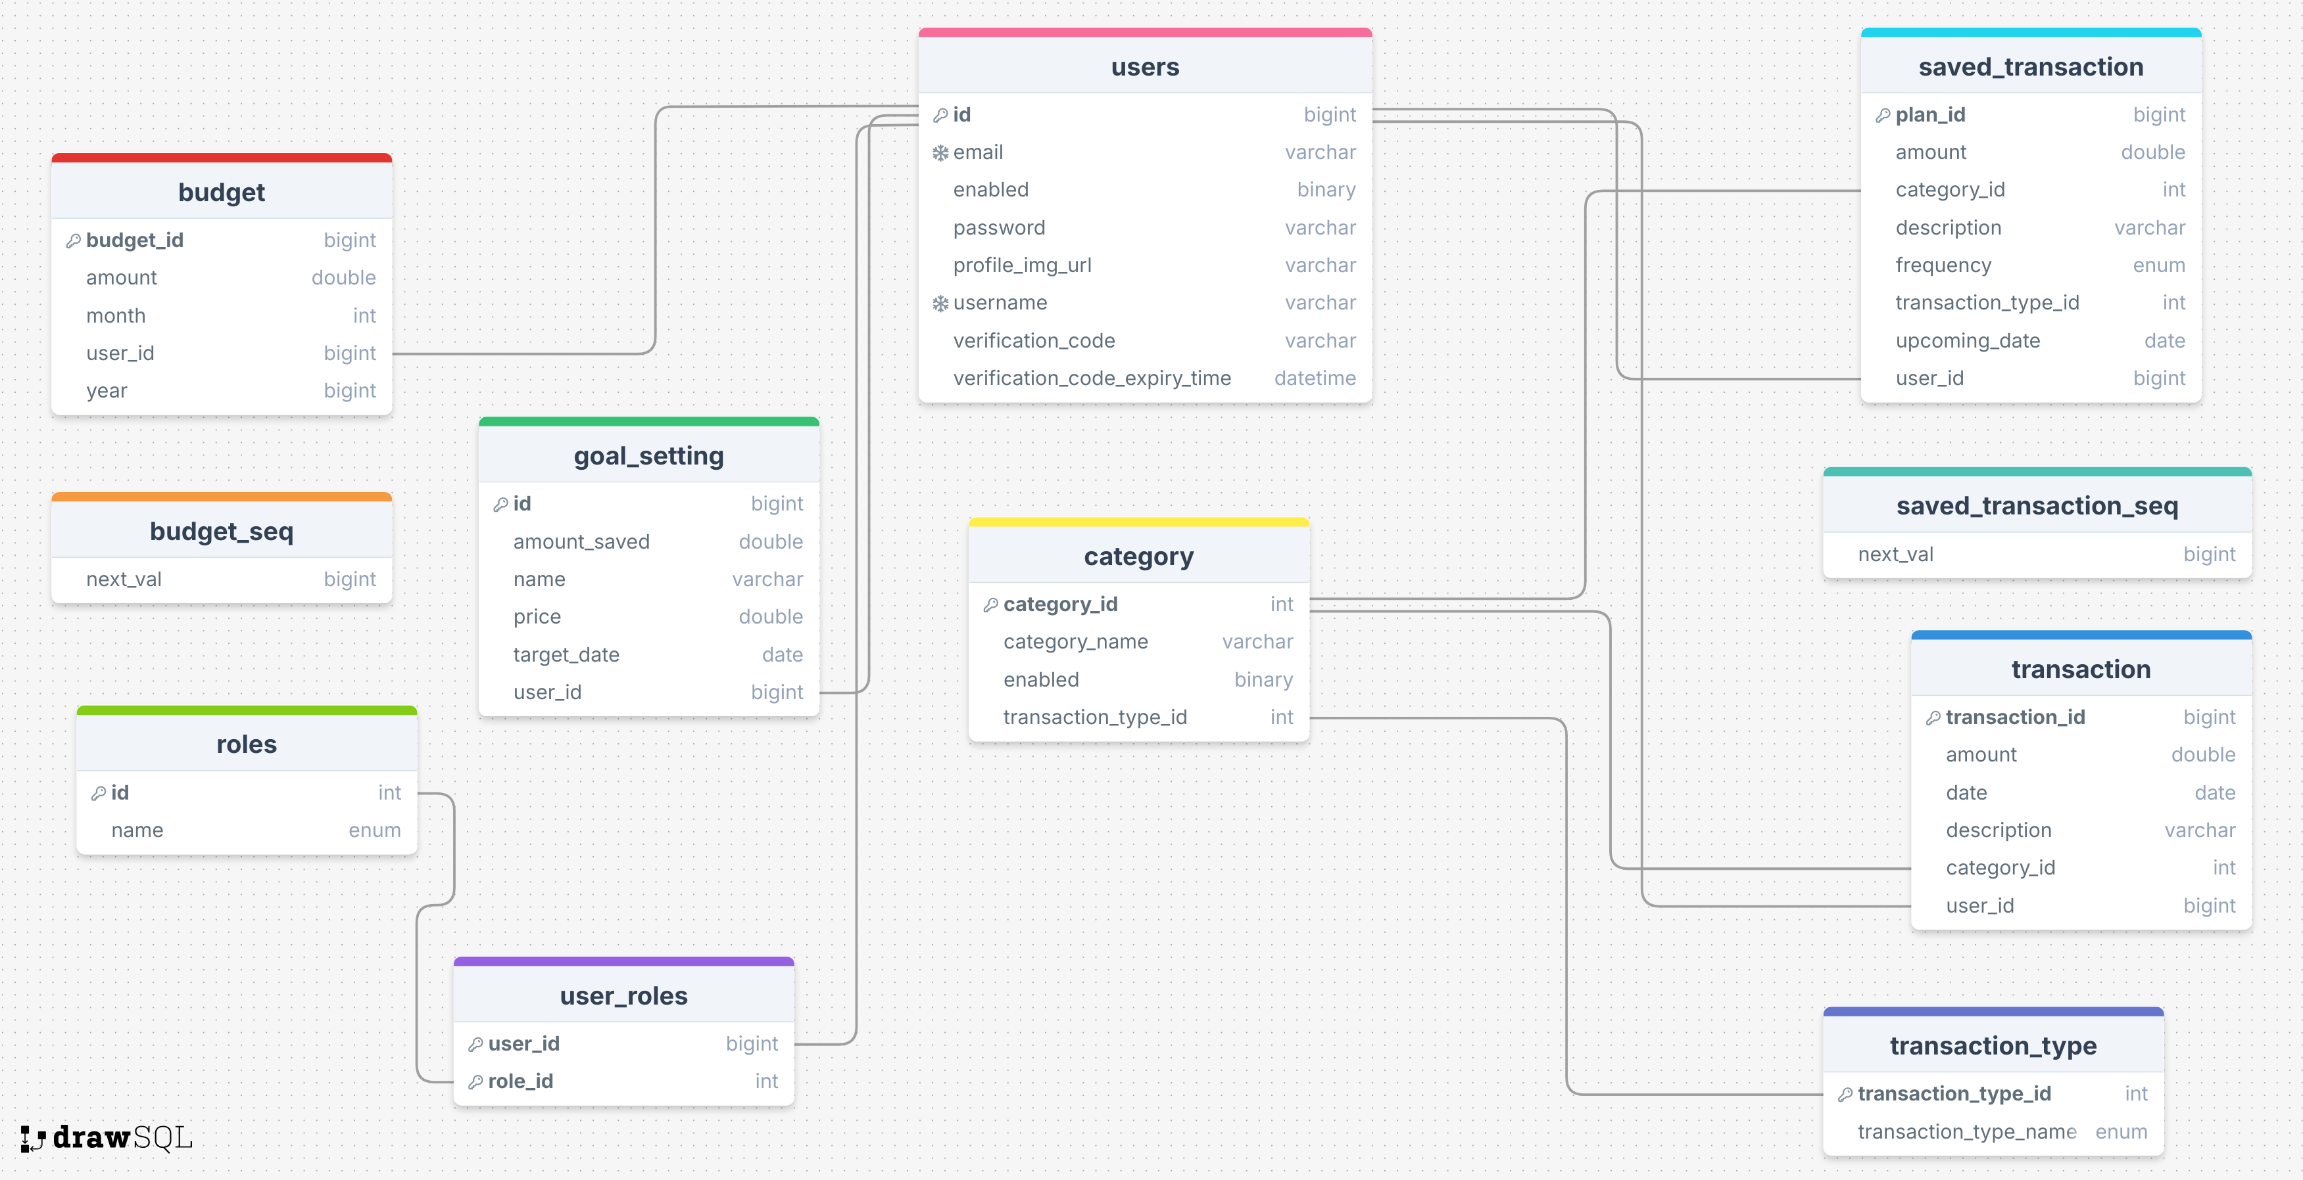
Database Design

Slide 8
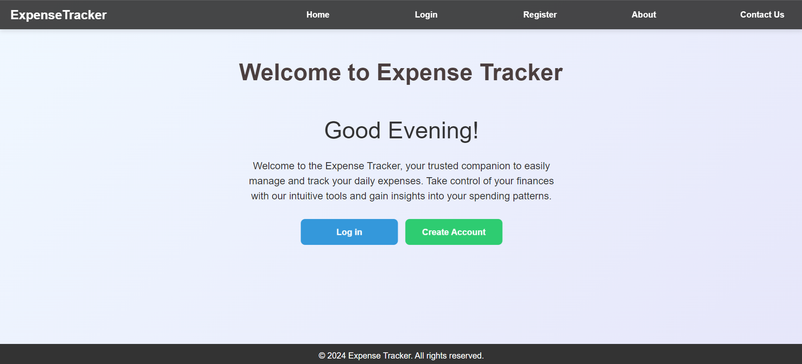
Home Page
This is the initial interface displayed to users upon their first interaction with our website.

Slide 9
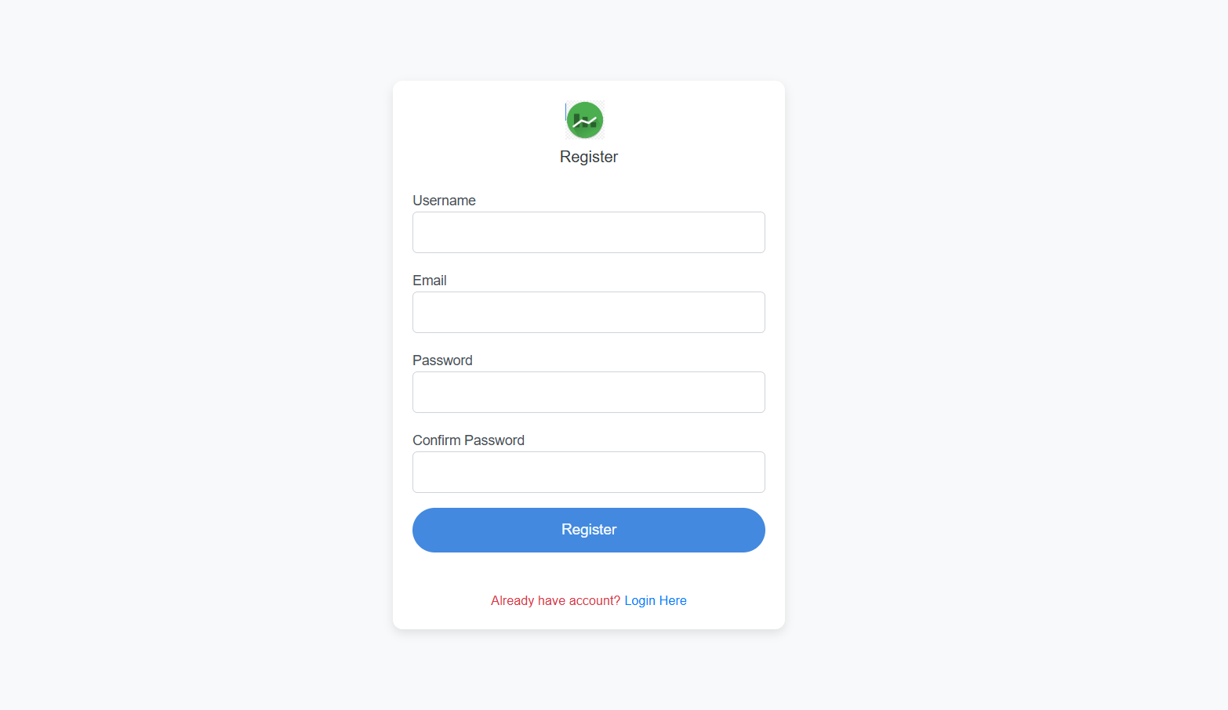
Registration page
Enter a unique username, provide a valid email for verification, set a secure password, and confirm it to complete the account setup.

Slide 10
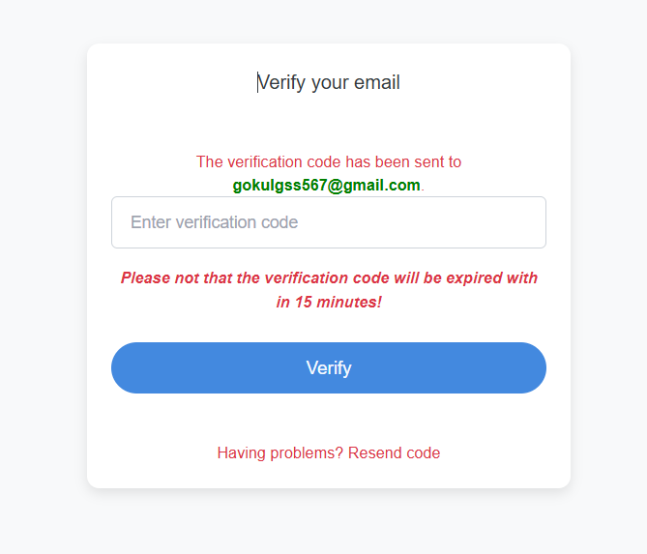
Email verification for Registration
A verification email with a Verification code will be sent to the provided email address for
account verification.

Slide 11
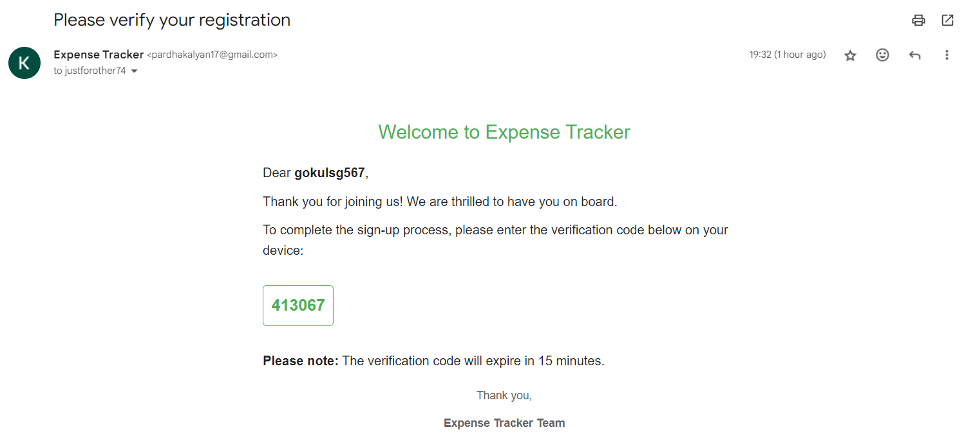
Email with Verification code

Slide 12
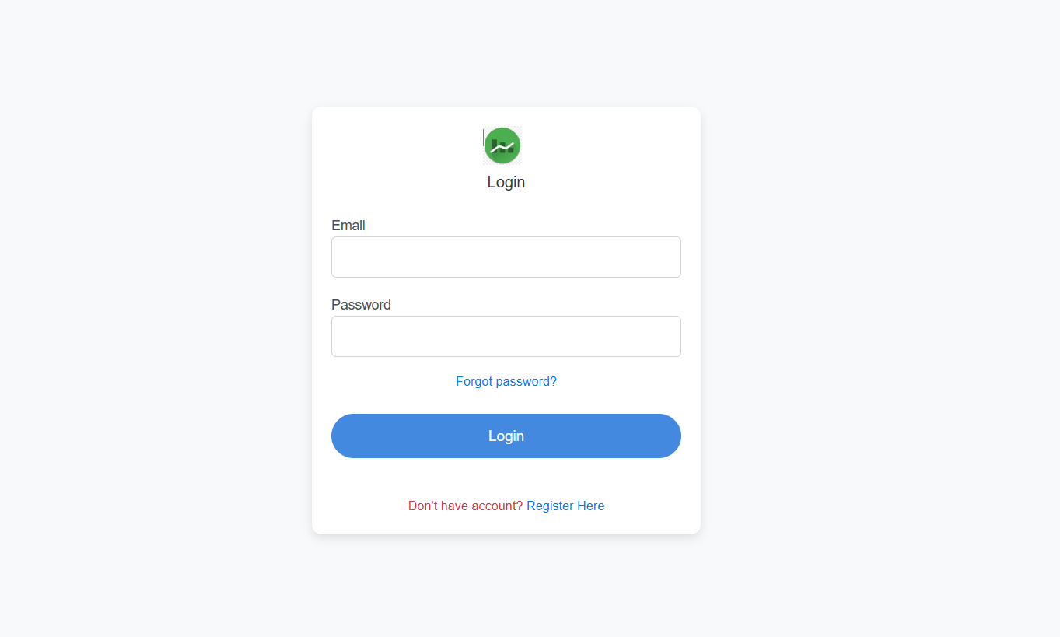
Login page
Enter your registered email and secure password to access your account.

Slide 13
Email verification for Forgot Password
A verification email will be sent to the registered email id

Slide 14
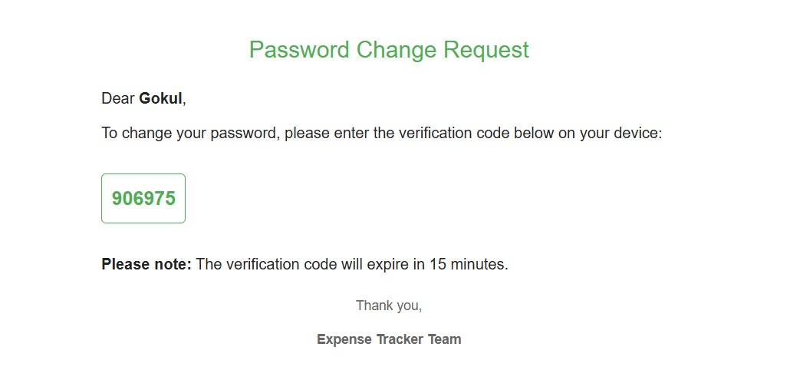
OTP Verification
Subsequently, a Verification code will be sent to registered email address to verify identity for password reset.

Slide 15
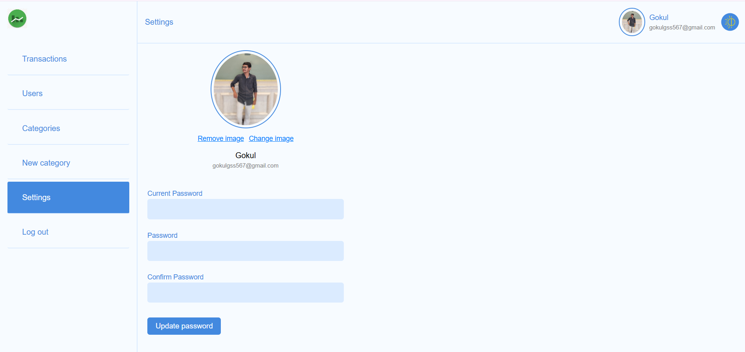
Settings
Profile Management
Upload, update, or delete your profile image to personalize your account.

Slide 16
Settings
Password Management:
Verify your identity by entering the current password, set a new secure password, and click "Update" to save the changes.

Slide 17
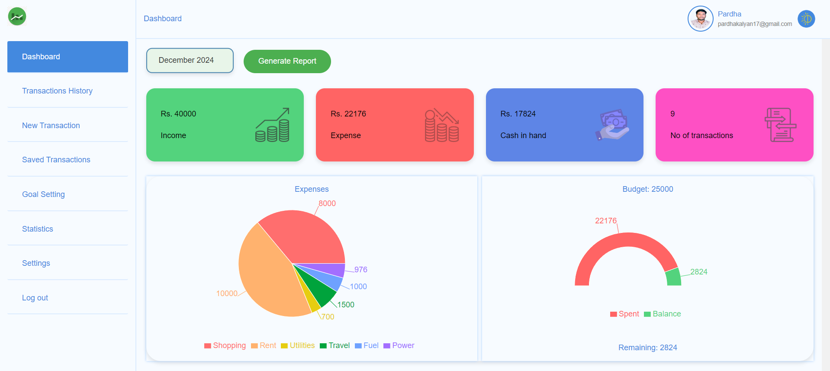
Dashboard
This is the dashboard view, which includes the following components: Income, Expense, Cash in hand, Number of transactions, an Expense Chart, and a Budget-Setting.

Slide 18
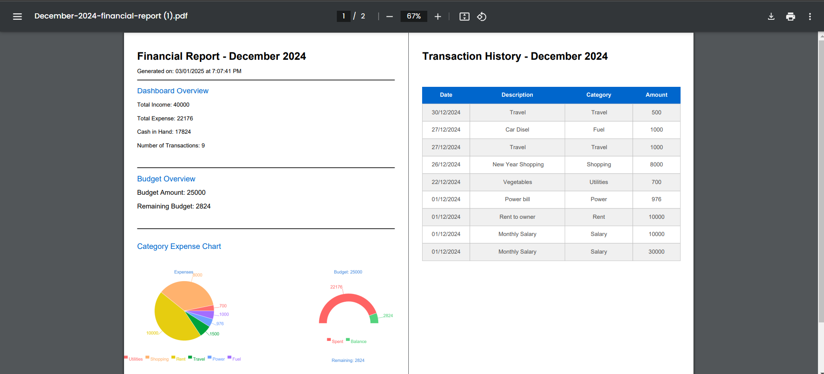
Report Generation
Upon clicking "Generate Report," a PDF is generated containing the following:
Dashboard Overview: A summary of key financial metrics.
Budget Overview: Insights into budget allocation and utilization.
Category Expense Chart: A visual breakdown of expenses by category.
Transaction History: A detailed record of transactions for the selected month.

Slide 19
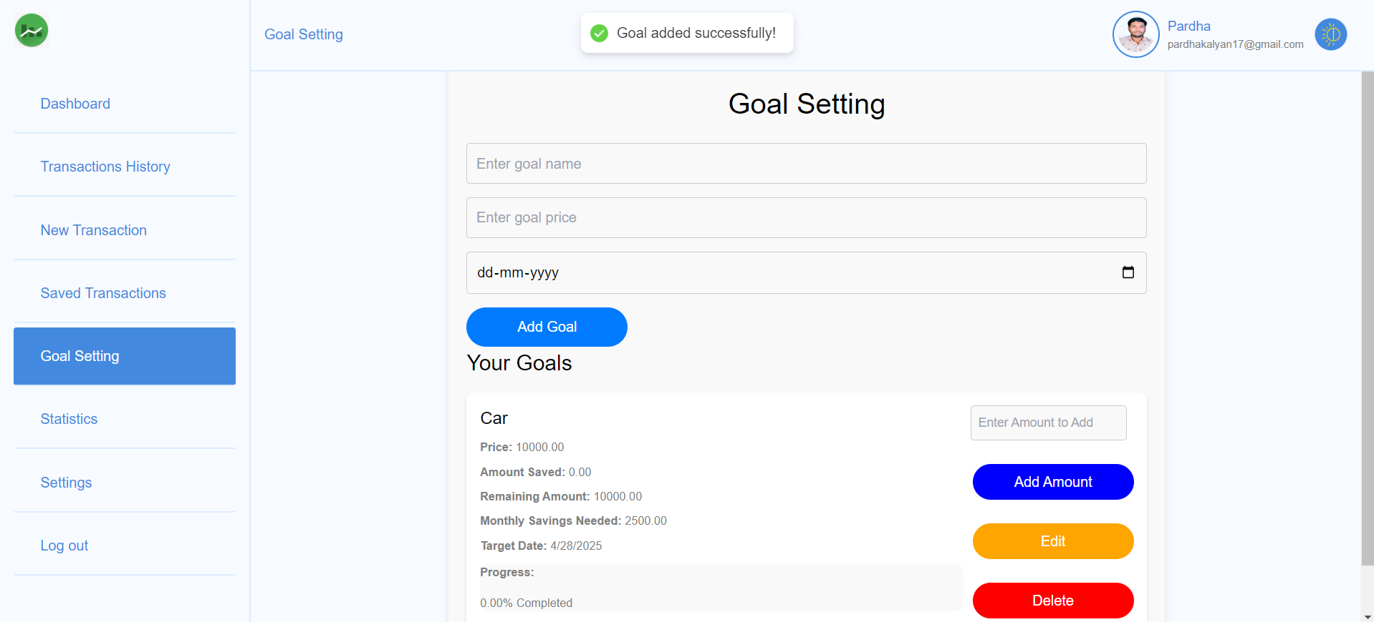
Goal Setting
This section allows users to define financial goals, track progress, and maintain accountability. Set specific targets for savings, expenses, or investments and monitor your journey toward achieving them with detailed insights and updates.

Slide 20
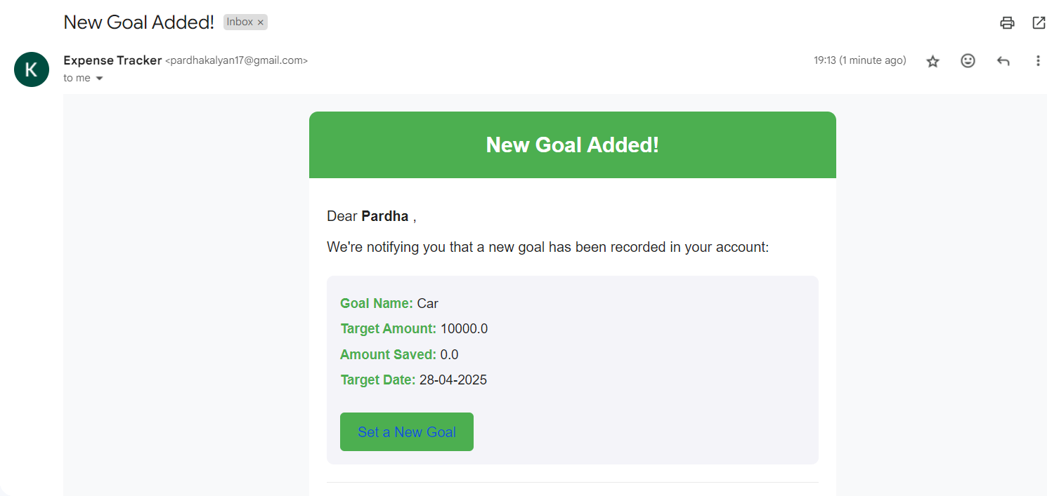
Goal Added Notification
An email notification will be sent whenever a new goal is created, keeping users informed and engaged.

Slide 21
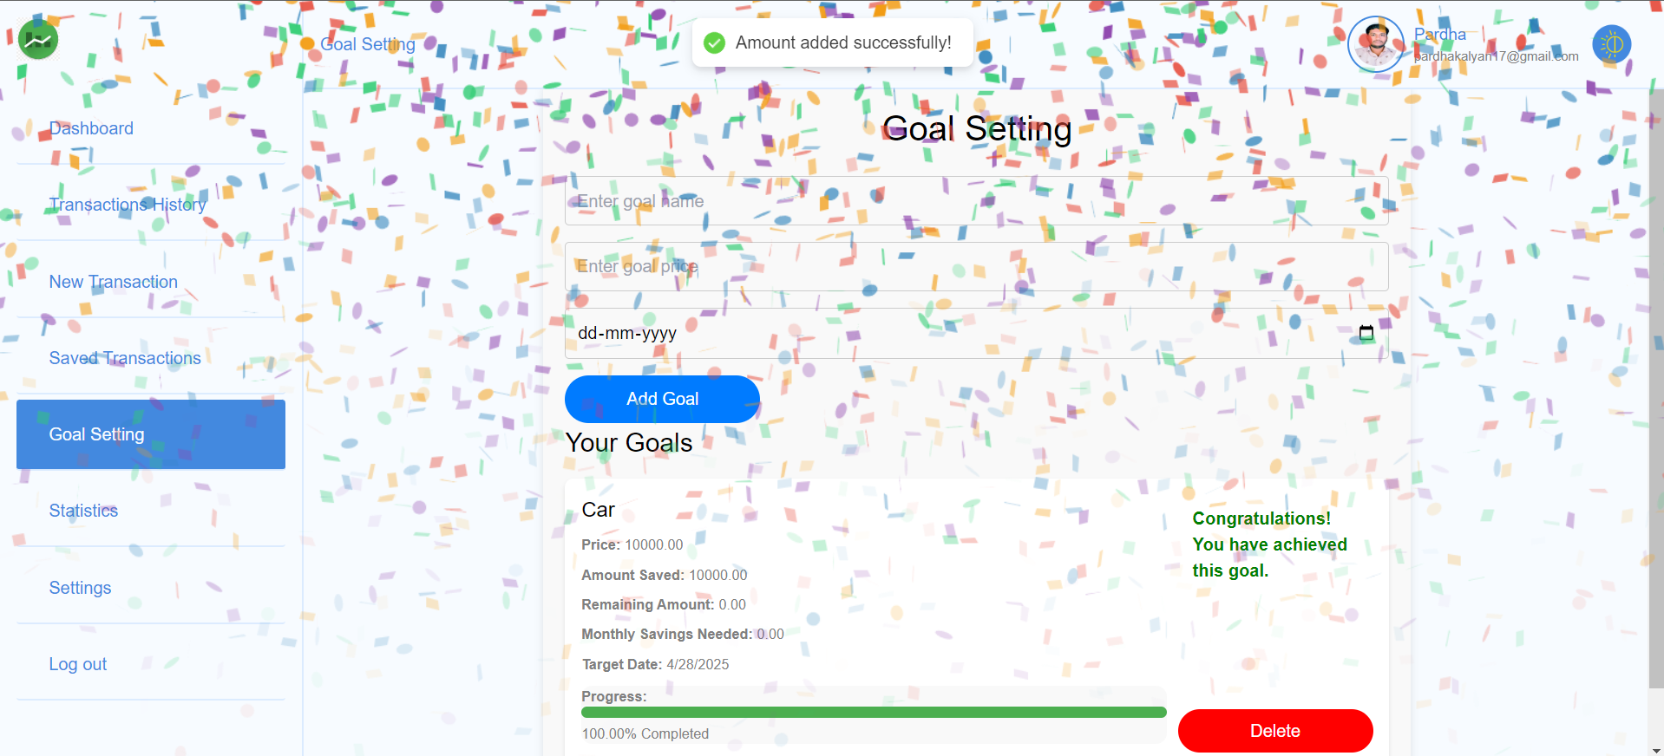
Goal Achieved
Upon goal completion, the "Add Amount" and "Edit" buttons will be disabled, and the user will be congratulated with a personalized message celebrating their achievement.

Slide 22
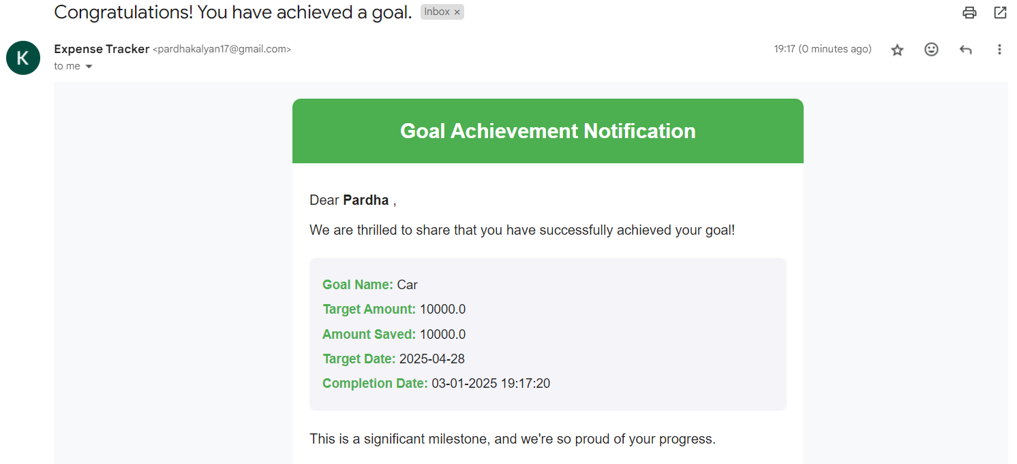
Goal Achievement Notification
An email notification will be sent upon its successful completion, keeping users informed and engaged.

Slide 23
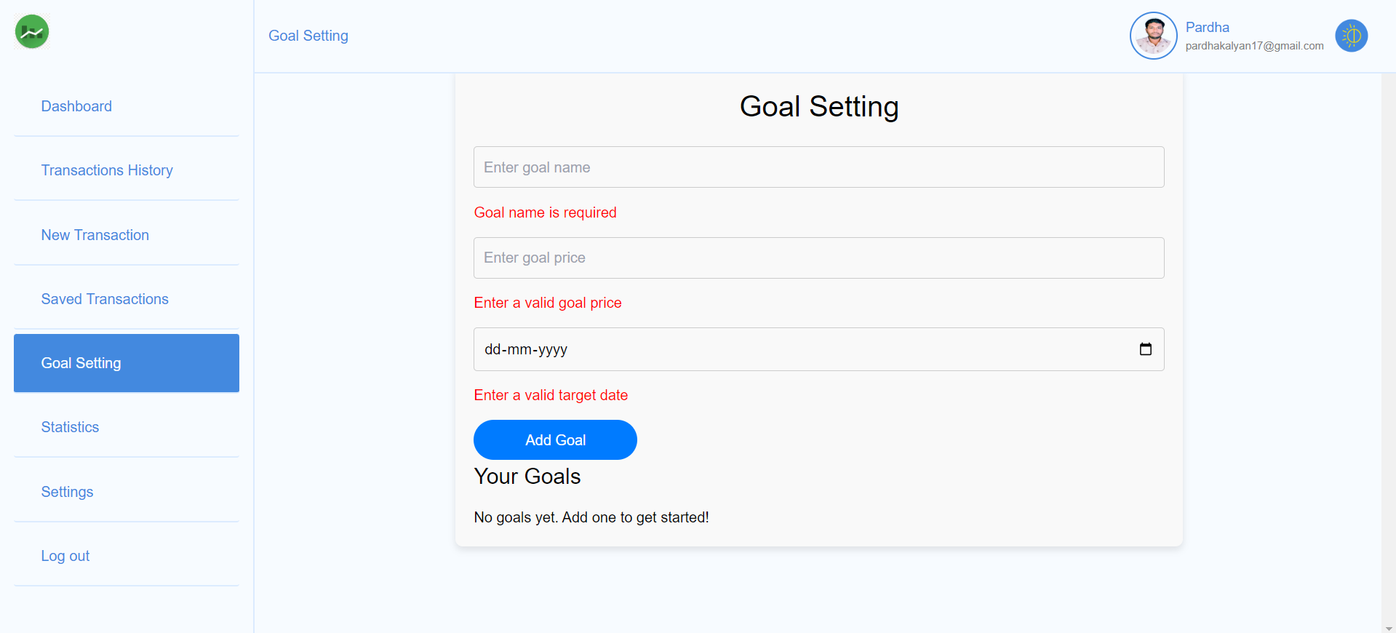
Form Validation : Goal Setting

Slide 24
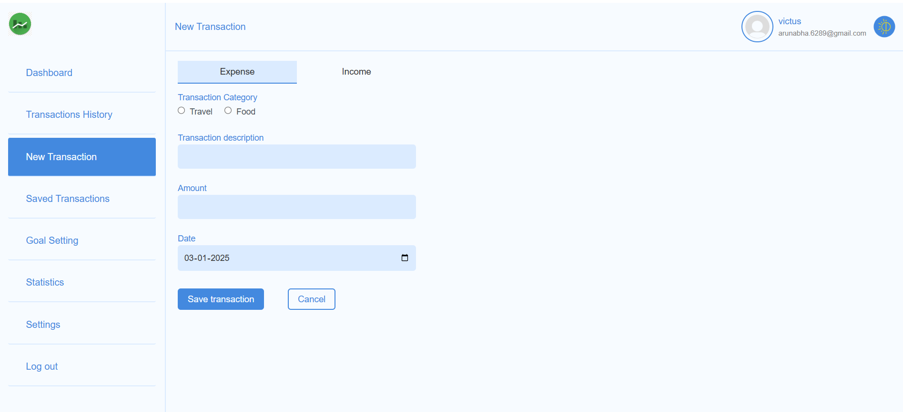
Transactions
We offer two types of transactions: Expense and Income, each with different categories to organize and track financial activities effectively.

Slide 25

Adding New Transaction
Users can add transactions by providing detailed information, including the type, category, amount, date, and description, ensuring accurate financial tracking.

Slide 26
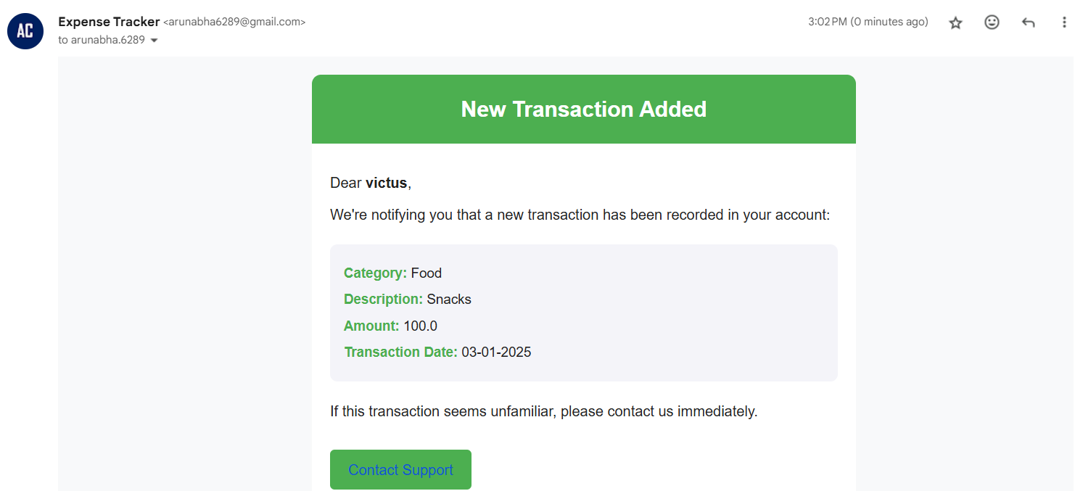
New Transaction Added Notification
An email notification will be sent whenever a new transaction is made, keeping users informed and engaged.

Slide 27
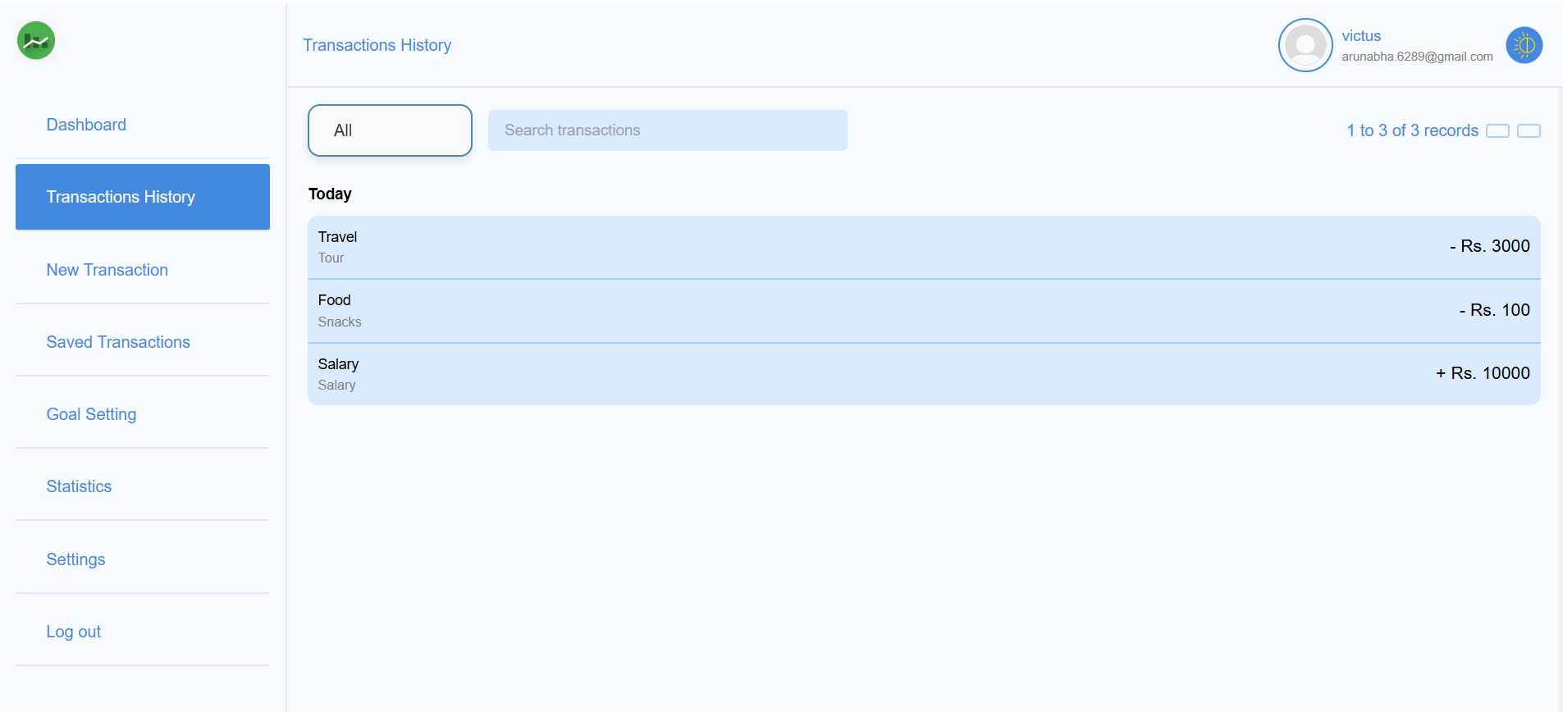
Transaction History
Users can view and manage their transactions through the Transaction History, which provides a detailed and organized record of all financial activities.

Slide 28
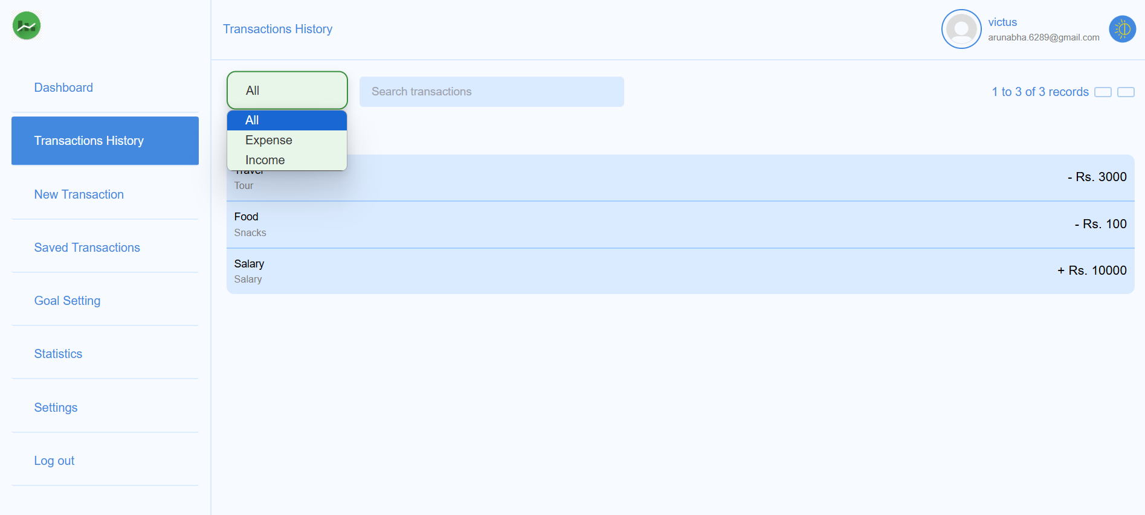
Apply Filter for Searching Transactions
Users can refine their search or locate specific transactions using filtering and search functionalities within the Transaction History section.

Slide 29
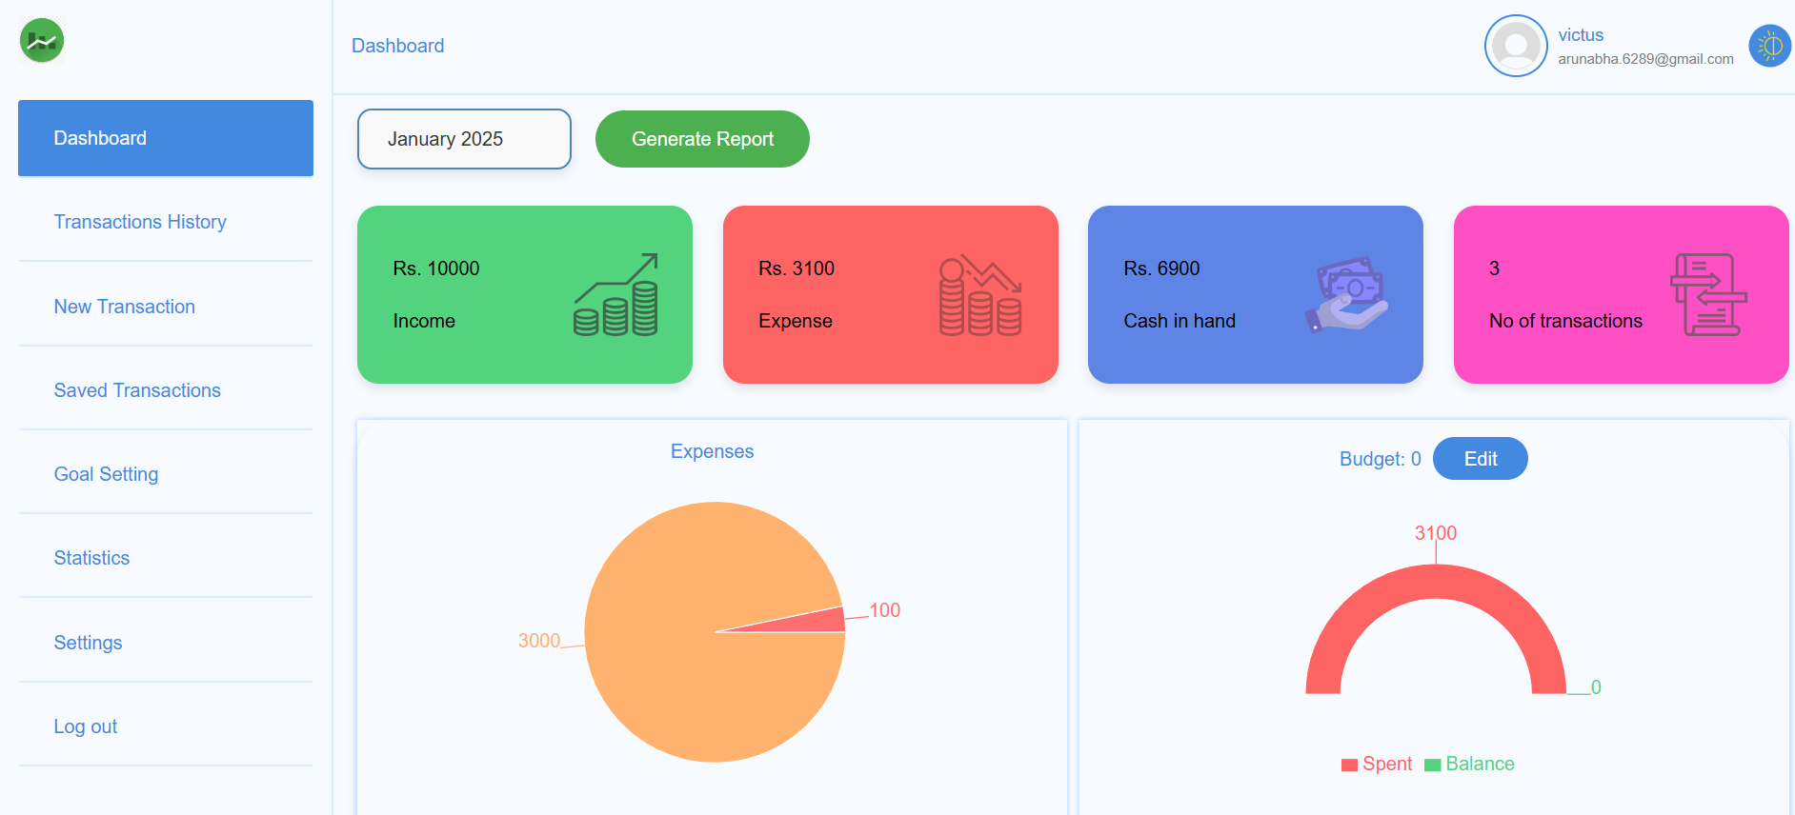
Dashboard with Updated Transactions
Transactions are seamlessly updated on the dashboard, providing users with a clear and real-time overview of their financial activity.

Slide 30
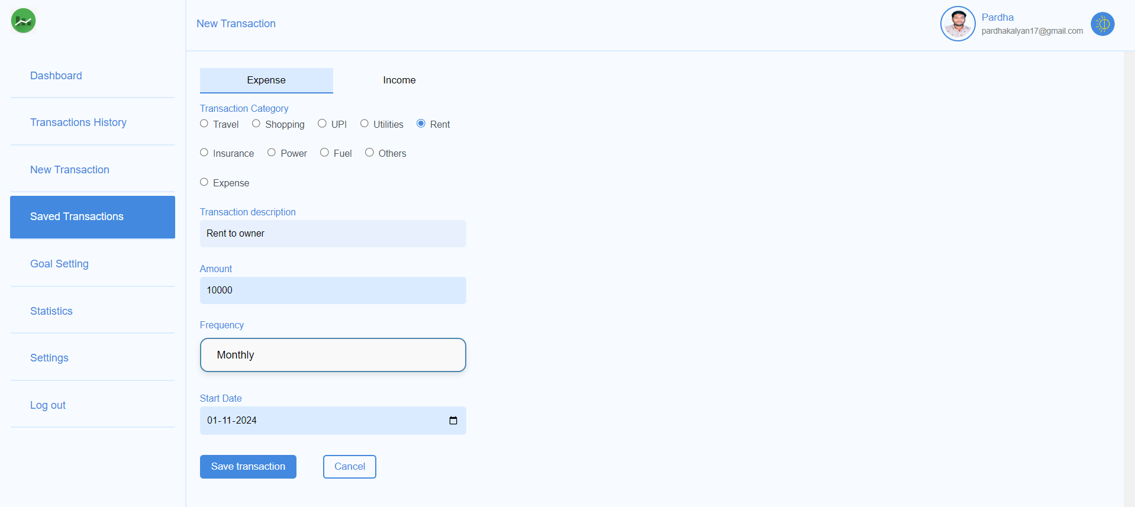
New Saved Transaction
Create and save a new transaction, including details for one-time or recurring expenses and income, for automated tracking and easy management.

Slide 31
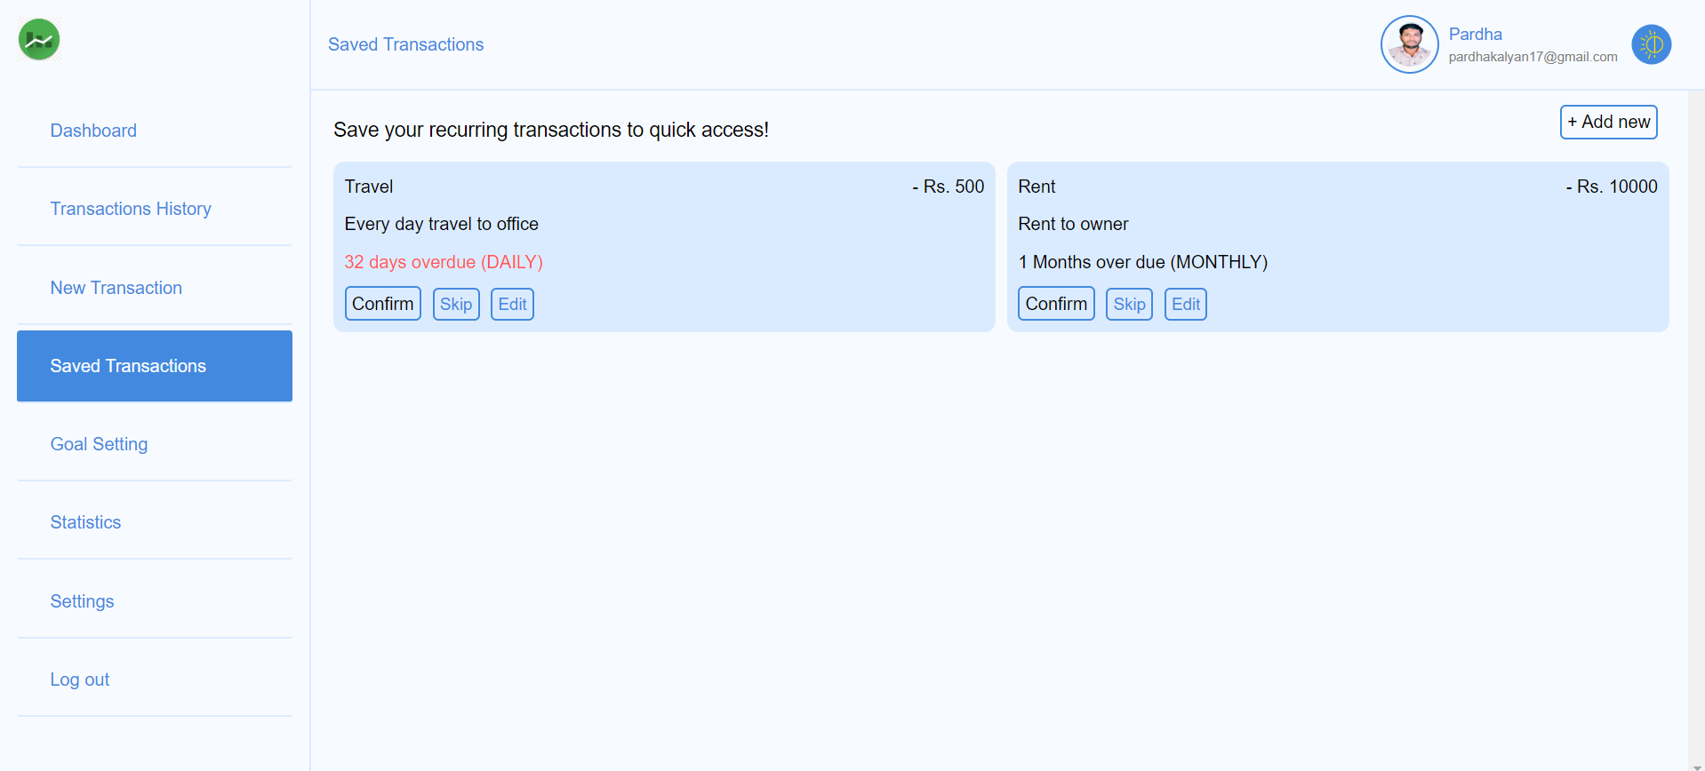
Saved Transactions
This feature allows users to store and automate recurring transactions, ensuring accurate financial tracking. Users can easily manage, edit, or delete saved transactions as needed.

Slide 32
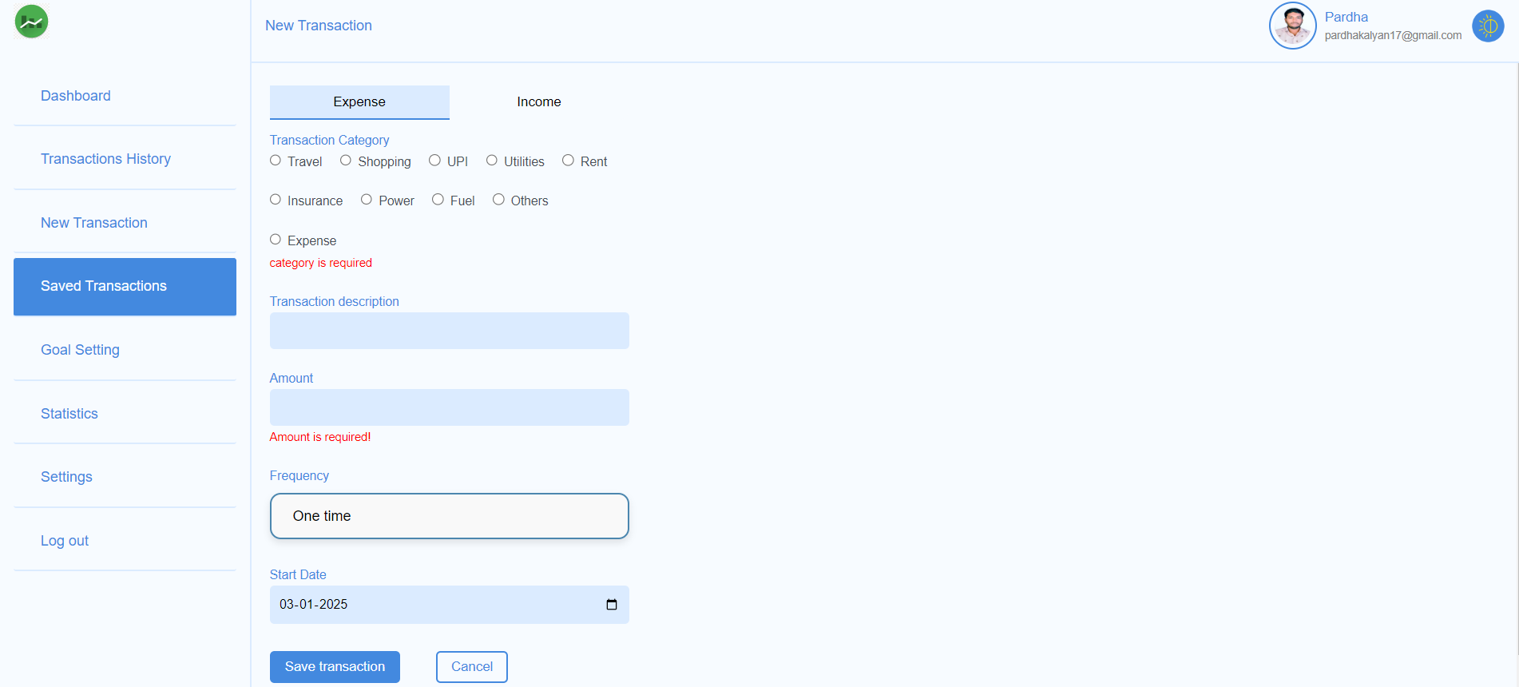
Form Validation : Saved Transactions

Slide 33
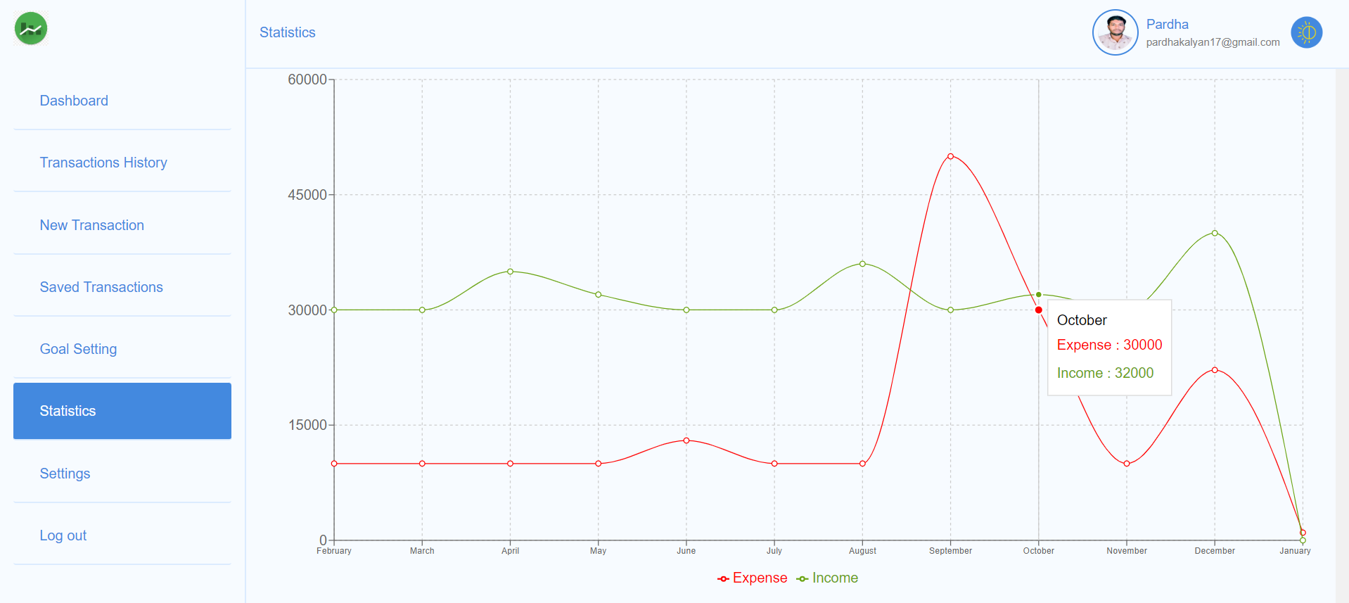
Statistics
The Statistics section offers an interactive Expense vs. Income graph, with hover functionality to display total expenses and income for each month. It provides a comprehensive overview of financial data, including spending patterns, income trends, and budget performance, enabling users to make informed decisions.

Slide 34
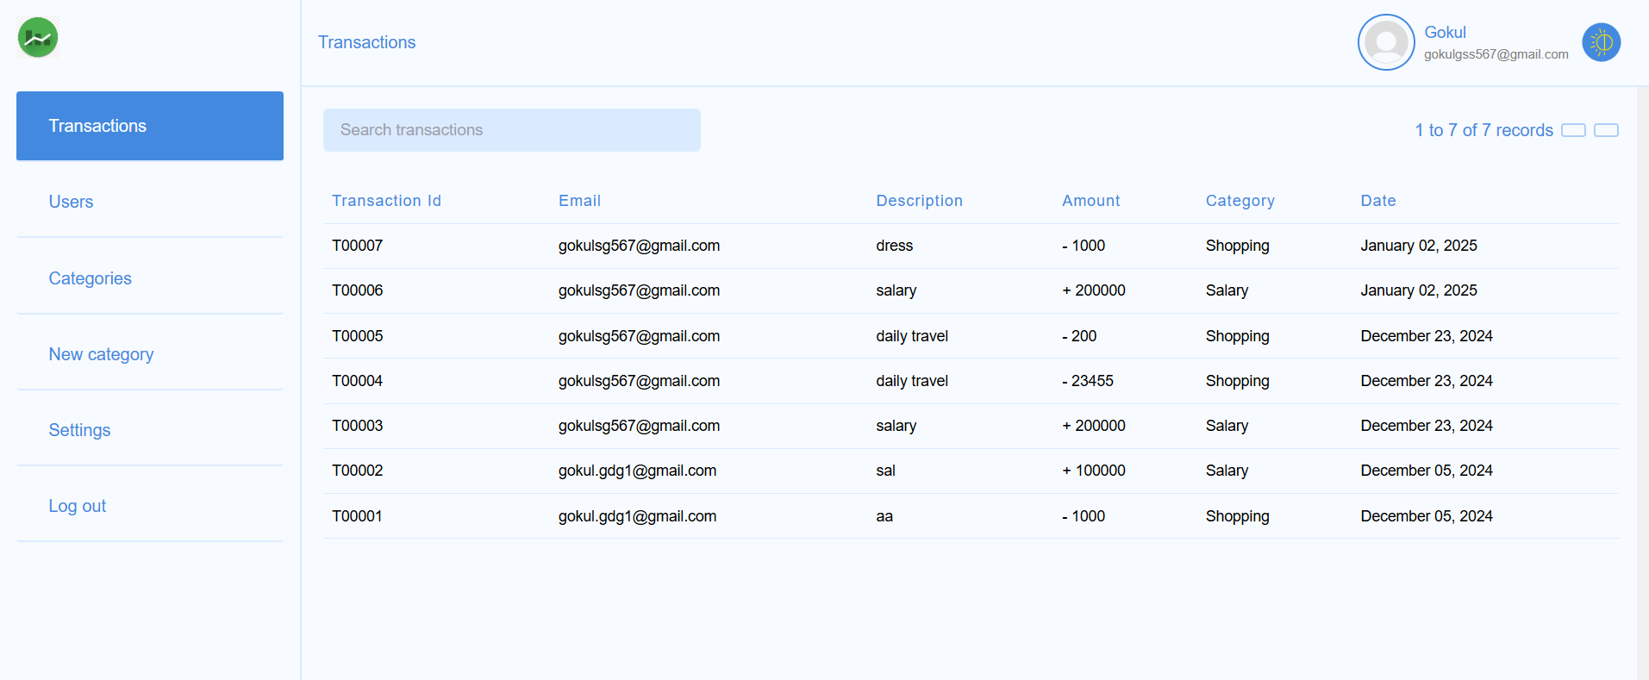
Transactions(Admin)
Admin Transaction Overview:
The admin can view all users, track their transaction history, and access details such as transaction ID, description, email ID, amount, category, and transaction date.

Slide 35
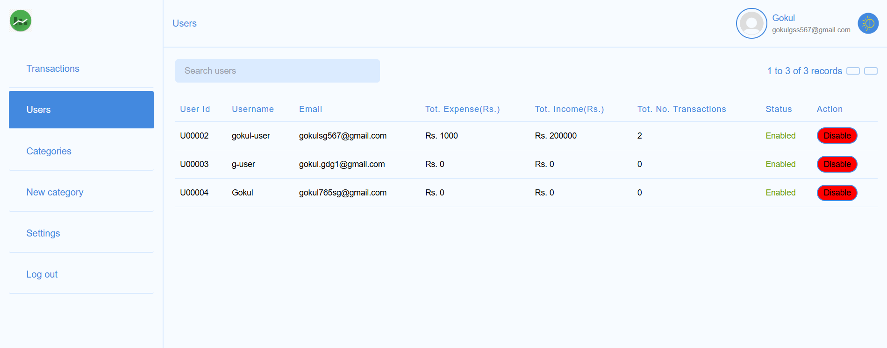
Users (Admin part)
Admin User Management
The admin can:
Enable or Disable Users: Control user access to the platform by toggling their status.
View User Statistics: Check each user's total expenses, total income, and the number of transactions

Slide 36
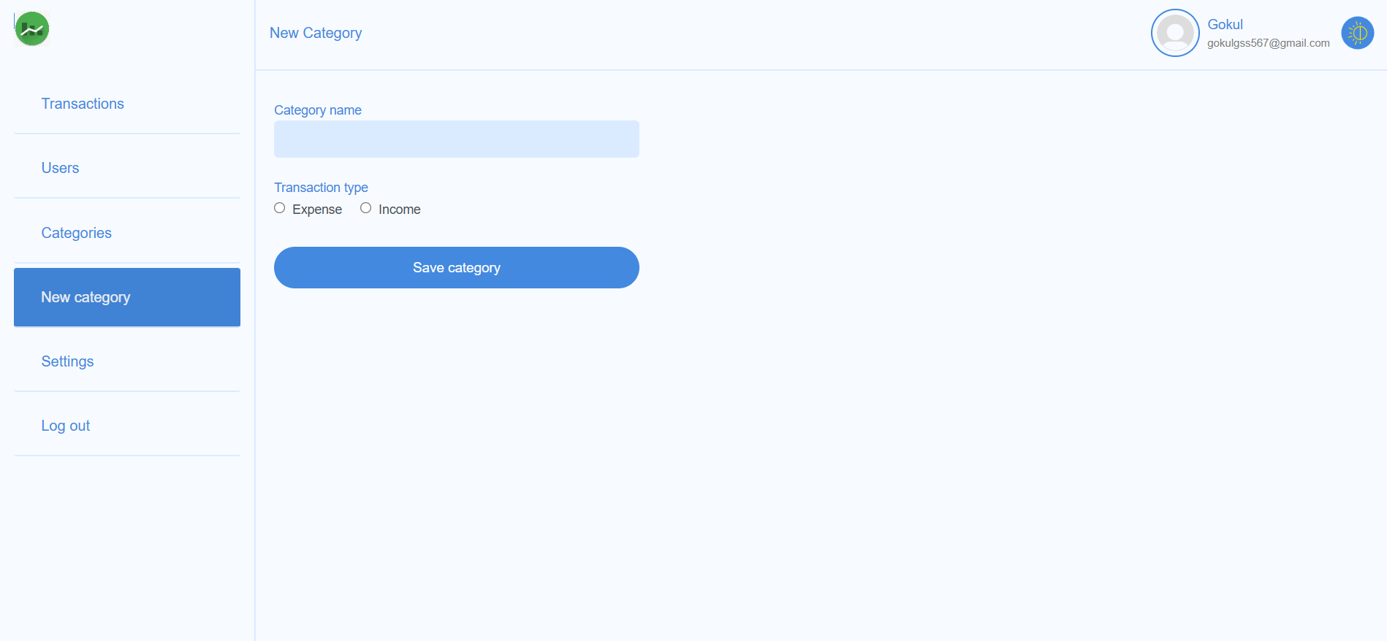
New Category(Admin)
The admin can create new category types for both income and expenses, enabling users to categorize their transactions effectively.

Slide 37
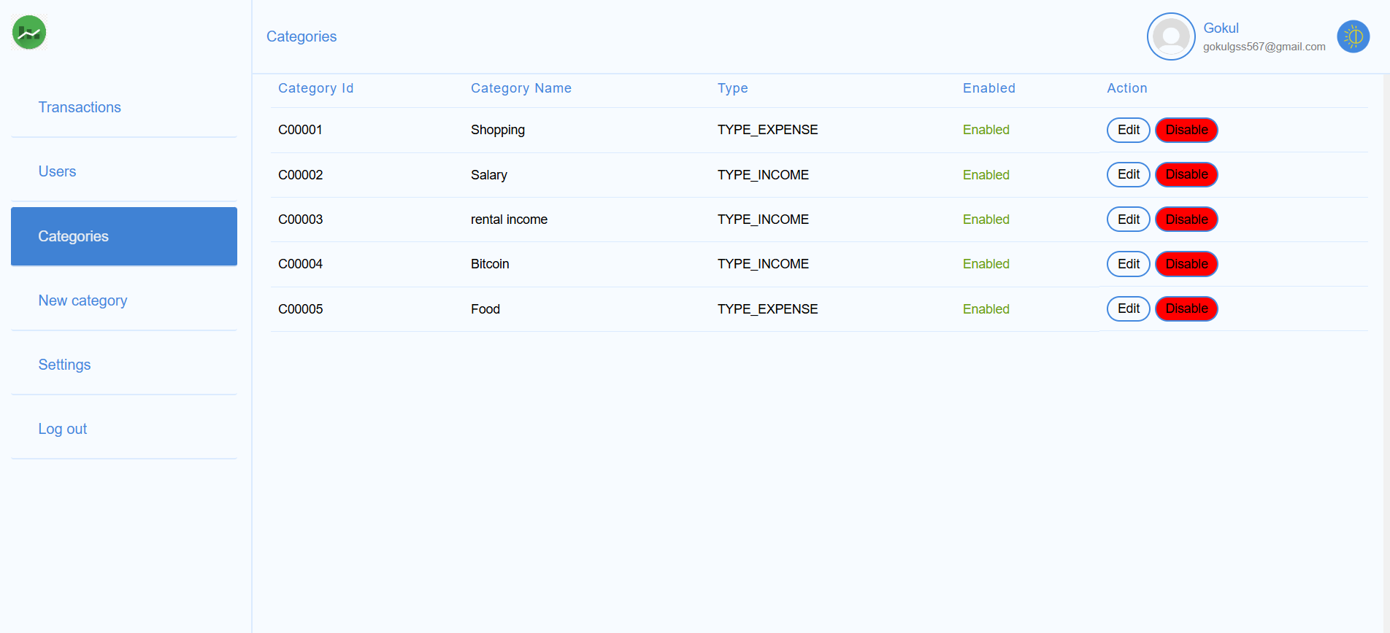
Categories(Admin)
The admin can edit or disable existing categories and view the status of each category, indicating whether it is enabled or disabled.

Slide 38
Conclusion
The Expense Management System is a user-friendly platform offering a wide range of functionalities to simplify personal finance management.
With its advanced features for both users and administrators, the system ensures a comprehensive approach to tracking and optimizing financial health.
By leveraging cutting-edge technologies like Spring Boot and React.js, the application guarantees performance, scalability, and a seamless user experience.

Slide 39

Does anyone have any questions or need further clarification?

Slide 40


